Slide 1
Boston AQI Analysis
Hongwei Hu
Guangnan Liang

Slide 2
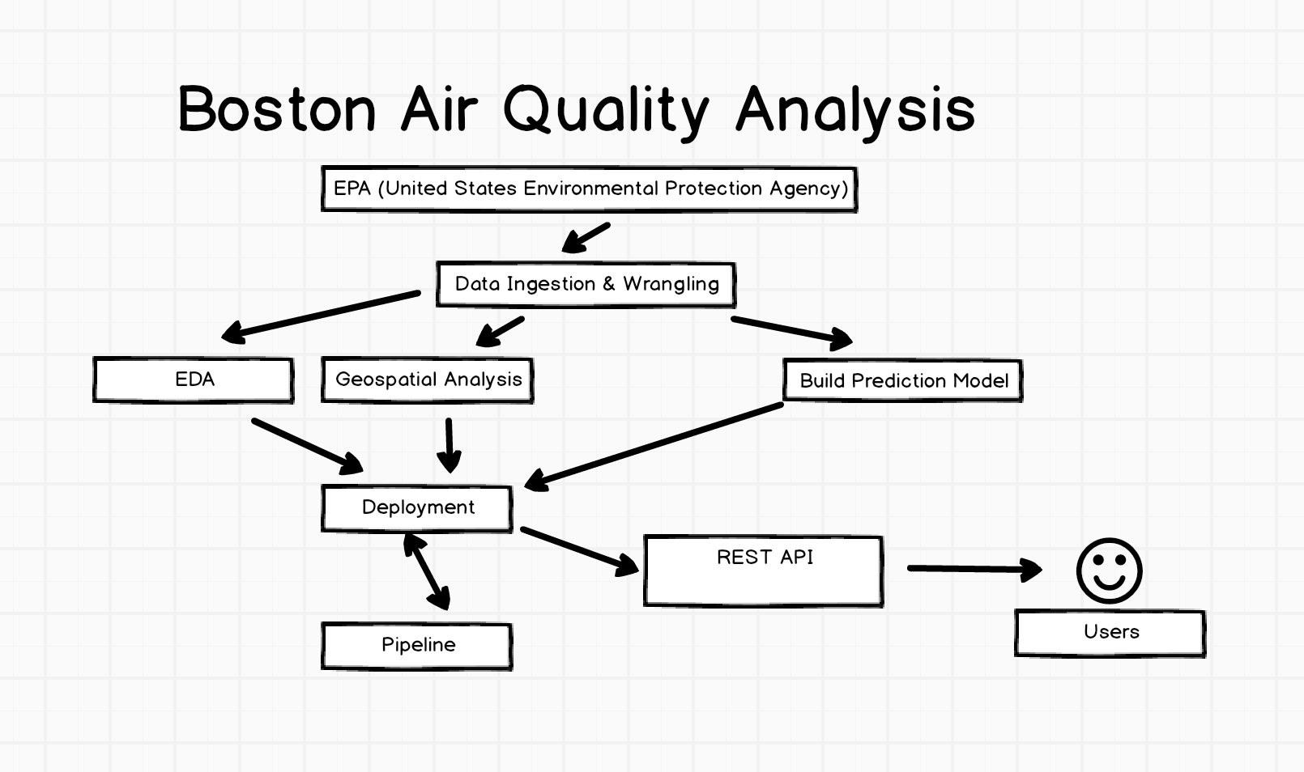
workflow

Slide 3
workflow

Slide 4
workflow
Data Ingestion & wrangling Automation
Azure Ml Model
Pipeline for regular fetching & retraining
Deployment

Slide 5
1. Data Ingestion & wrangling Automation
Docker Hub: besimilar/advanced-data-analysis:aqi
GitHub: https://github.com/Besimilar/Air-Quality-Analysis/tree/master/1-Data-Ingestion

Slide 6
1. Data Ingestion & wrangling Automation
Prepare “env.list”

Slide 7
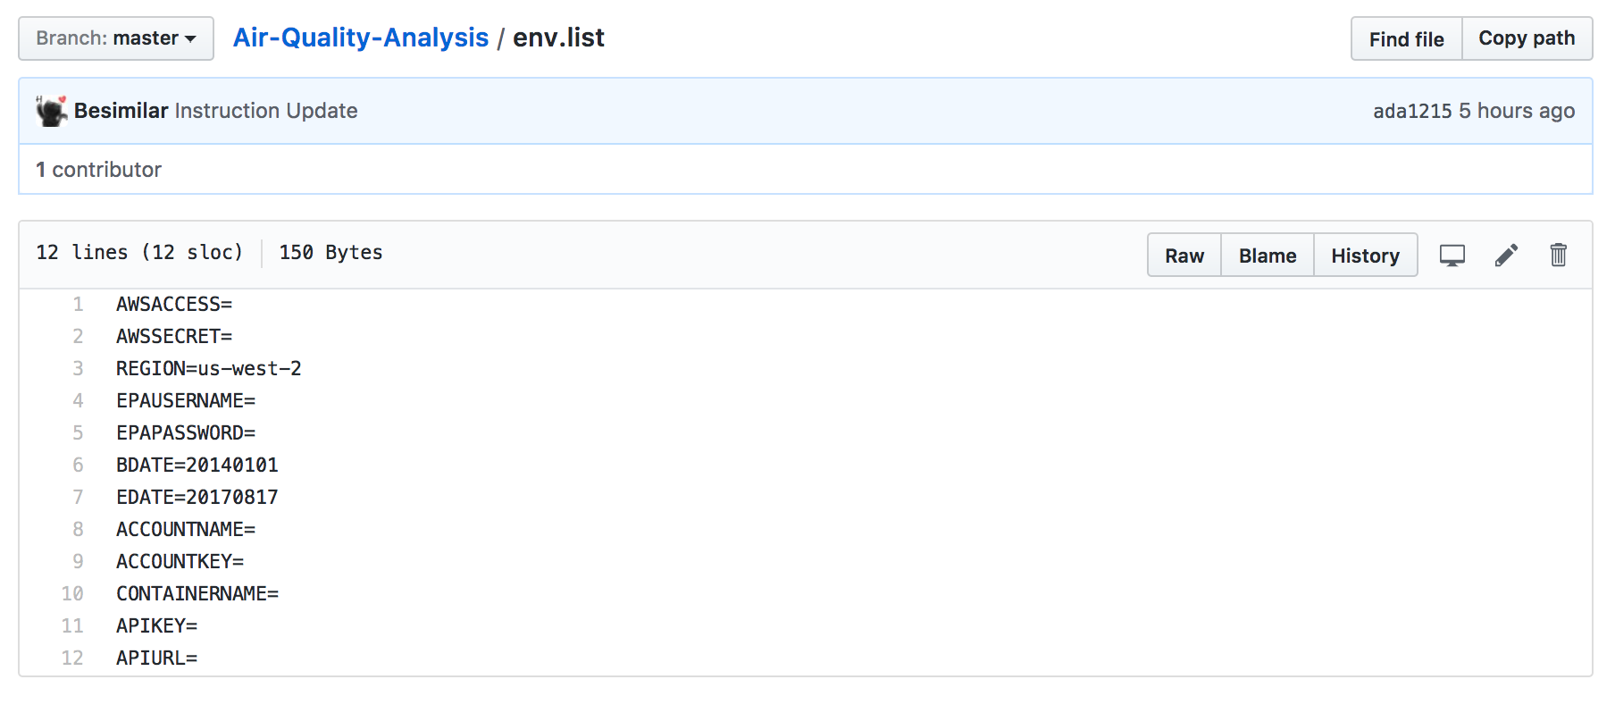
1. Data Ingestion & wrangling Automation
Prepare “env.list”

Slide 8
1. Data Ingestion & wrangling Automation
Prepare “env.list”
1. AWS params:
AWSACCESS: aws access key
AWSSECRET: aws private key
REGION: aws region
2. EPA API params:
EPAUSERNAME: EPA API username
EPAPASSWORD: EPA API password
BDATE: the first day of dataset (better within 3 years, try to set around 20140101, its a bug-free choice)
EDATE: the last day of dataset: (default: current date)

Slide 9
1. Data Ingestion & wrangling Automation
Prepare “env.list”
BDATE: the first day of dataset (better within 3 years, try to set around 20140101, its a bug-free choice)
You might get error, if you fetch large data from EPA api, because they seem to limit my account.
You also might get error, if you fetch small data, because the data might not contain some predictive features, either wrangling or model retraining could produce "no features" errors.

Slide 10
1. Data Ingestion & wrangling Automation
Prepare “env.list”
3. Azure params:
ACCOUNTNAME: azure storage account name
ACCOUNTKEY: azure storage primary key
CONTAINERNAME: azure storage container name
4. Azure ML params:
APIKEY: predictive service key
APIURL: predictive service url

Slide 11
1. Data Ingestion & wrangling Automation
Prepare “env.list”
5. Other default params:
change them in "config.json" After starting container
You dont't need to change them to do a demo

Slide 12
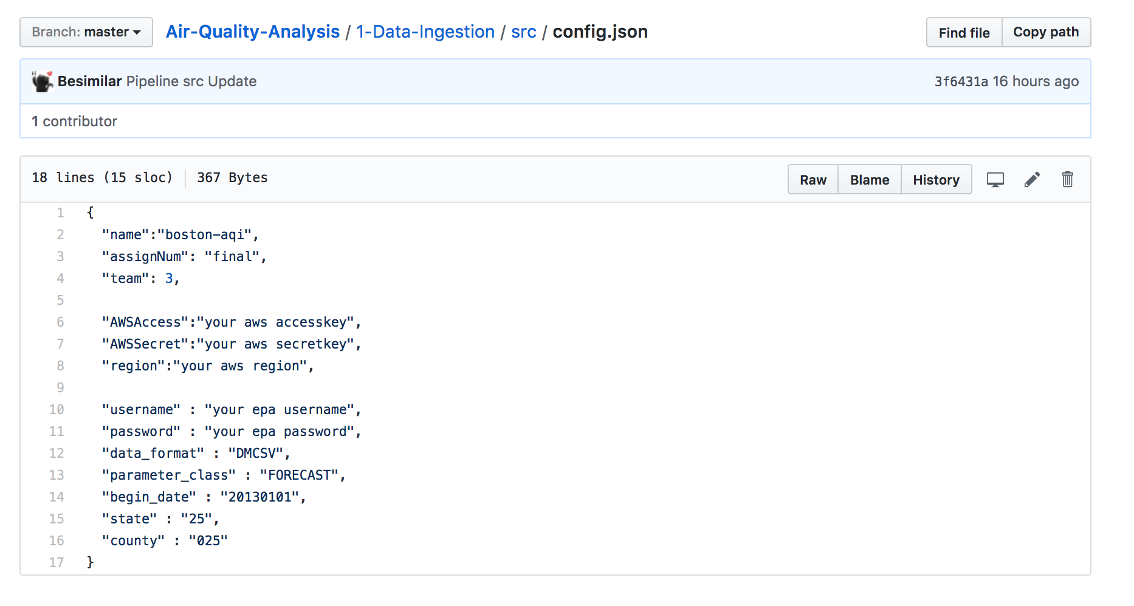
1. Data Ingestion & wrangling Automation
Prepare “env.list”
5. Other default params:
change them in "config.json" After starting container
You dont't need to change them to do a demo

Slide 13
1. Data Ingestion & wrangling Automation
Command Lines:
$ docker run --env-file env.list -w /Final/1-Data-Ingestion-Wrangling/data-ingestion -it besimilar/advanced-data-analysis:aqi
$ ./run.sh

Slide 14
1. Data Ingestion & wrangling Automation
Fetch rawdata from EPA API ("src/fetchdata.py"):

Slide 15
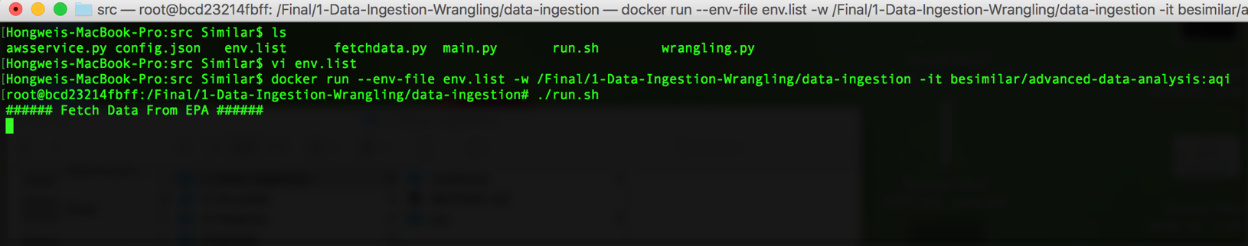
1. Data Ingestion & wrangling Automation
Fetch rawdata from EPA API ("src/fetchdata.py"):

Slide 16
1. Data Ingestion & wrangling Automation
Clean rawdata and save both rawdata and cleandata to local ("src/wrangling.py")

Slide 17
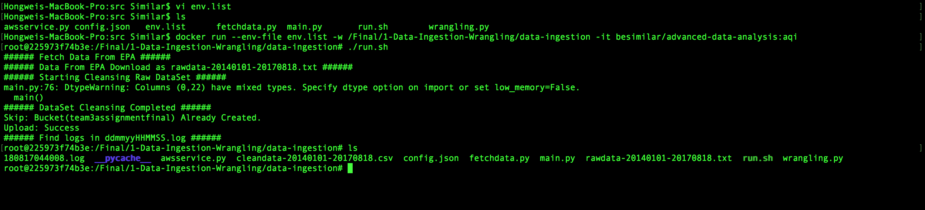
1. Data Ingestion & wrangling Automation
Clean rawdata and save both rawdata and cleandata to local ("src/wrangling.py")

Slide 18
1. Data Ingestion & wrangling Automation
Upload cleandata to AWS S3 ("src/awsservice.py"):

Slide 19
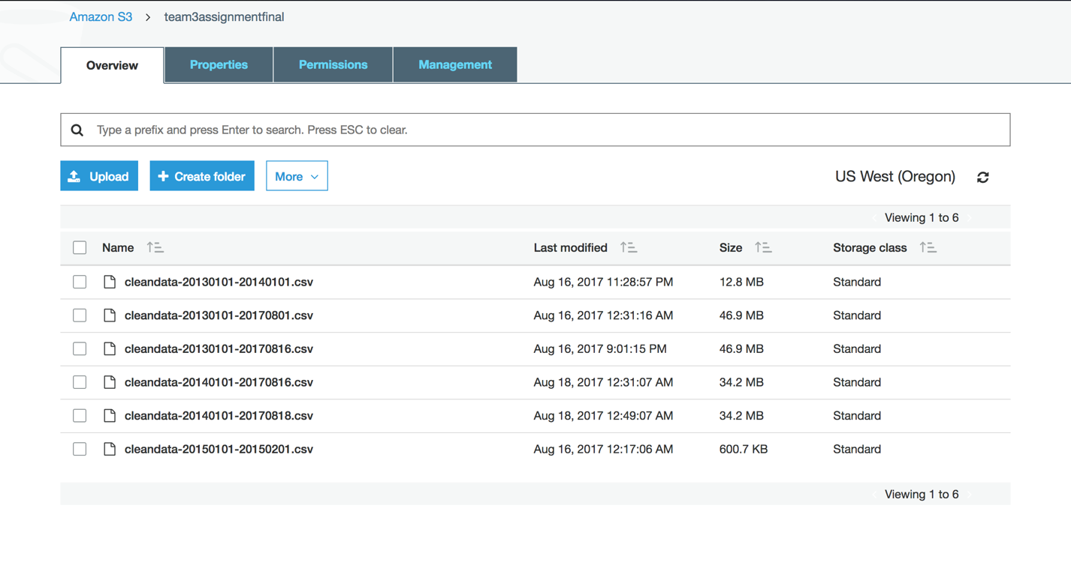
1. Data Ingestion & wrangling Automation
Upload cleandata to AWS S3 ("src/awsservice.py"):

Slide 20
1. Data Ingestion & wrangling Automation
Maintenance Issue:
The EPA API won't work on Sunday from 1800 to 2359. So avoid running this project during that time.

Slide 21
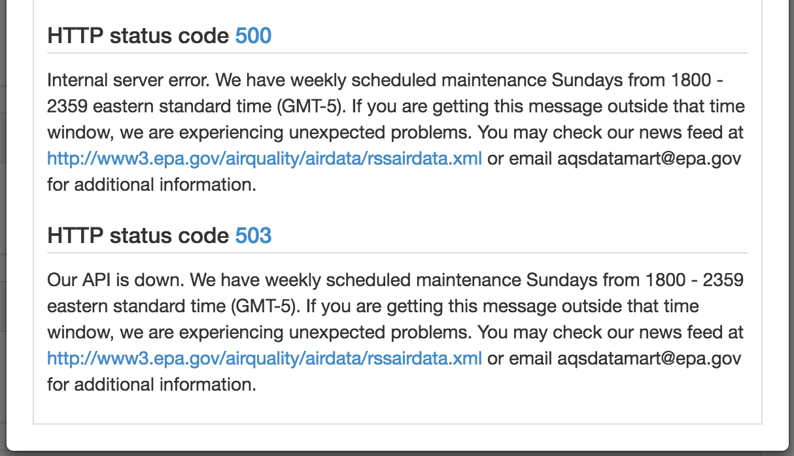
1. Data Ingestion & wrangling Automation
Maintenance Issue:
The EPA API won't work on Sunday from 1800 to 2359. So avoid running this project during that time.

Slide 22
2. Azure Ml Model
Azure Gallery:
https://gallery.cortanaintelligence.com/Experiment/Boosted-Decision-Tree

Slide 23
2. Azure Ml Model
Y: PM2.5 AQI (Particulate Matter)

Slide 24
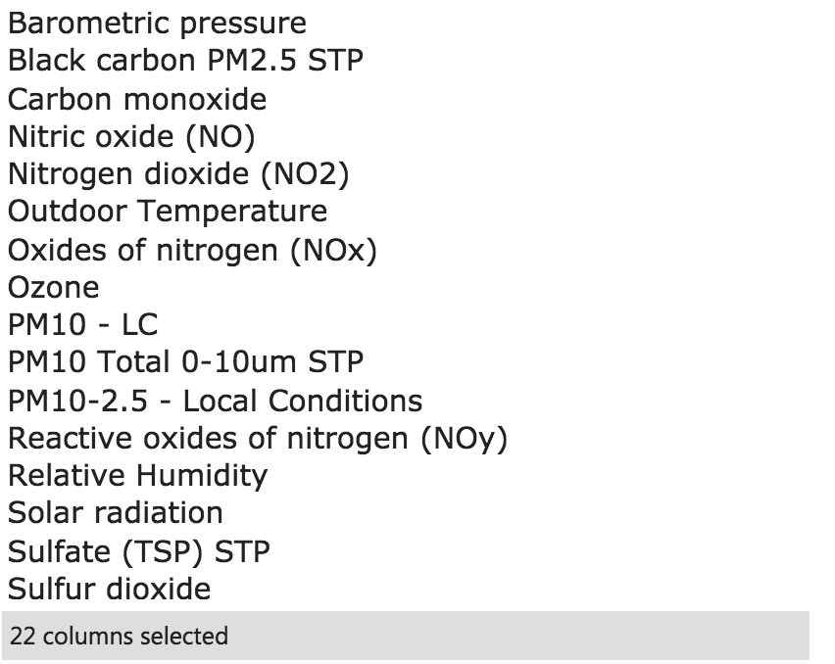
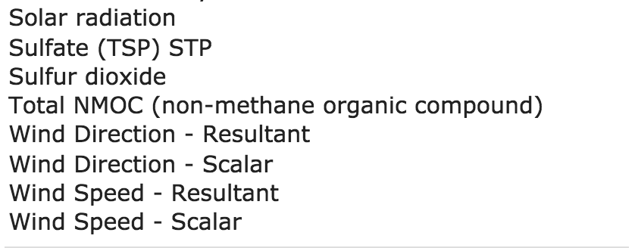
2. Azure Ml Model
X

Slide 25
2. Azure Ml Model
Algorithms:
Boosted Decision Tree
Neural Network
Decision Forest

Slide 26
2. Azure Ml Model
Best model: Boosted Decision Tree Regression

Slide 27
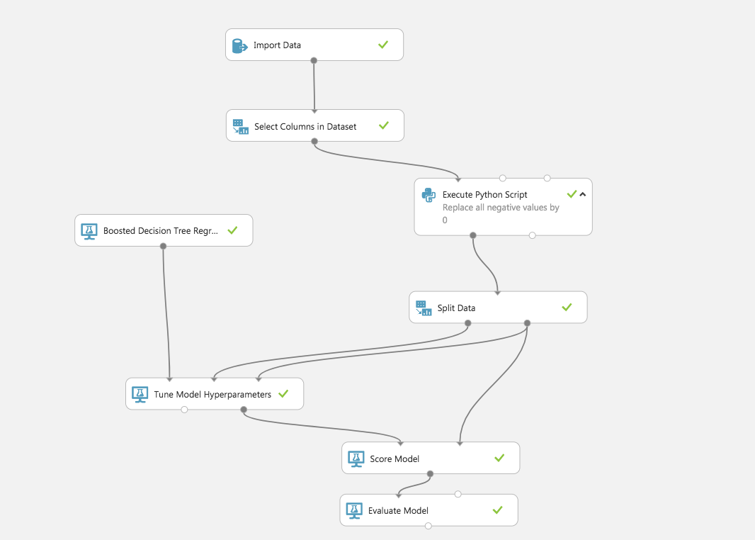
2. Azure Ml Model
Best model: Boosted Decision Tree Regression

Slide 28
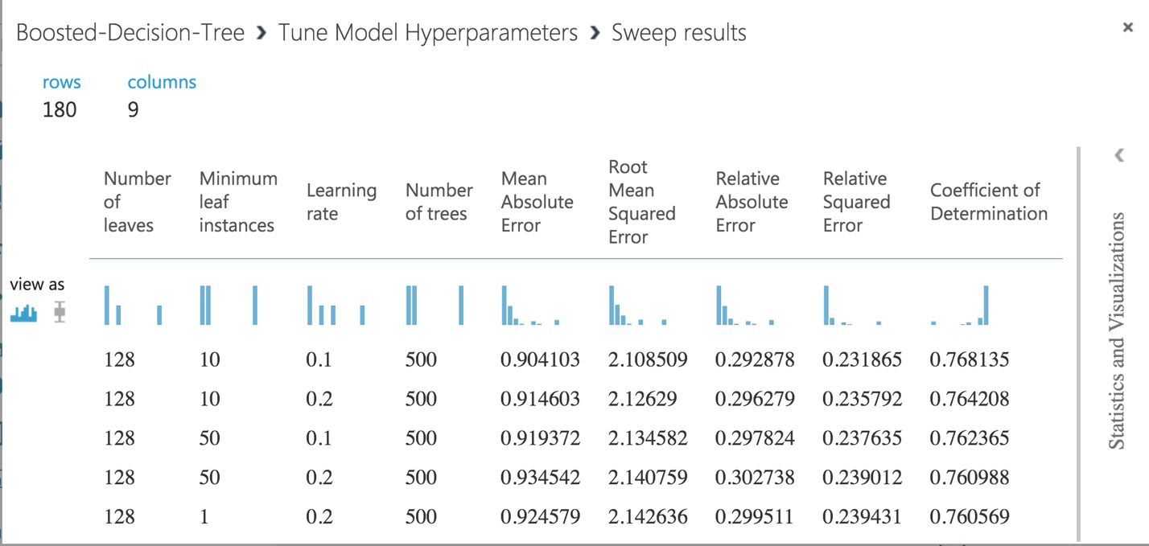
2. Azure Ml Model
Best model: Boosted Decision Tree Regression

Slide 29
3. Pipeline for regular fetching & retraining
Docker Hub: besimilar/advanced-data-analysis:pipeline
GitHub: https://github.com/Besimilar/Air-Quality-Analysis/tree/master/4-Pipeline

Slide 30
3. Pipeline for regular fetching & retraining
For demo:
the job will be run every 2 hour. If you need to run every day, please uncomment code in "src/Pipeline/celery.py"

Slide 31
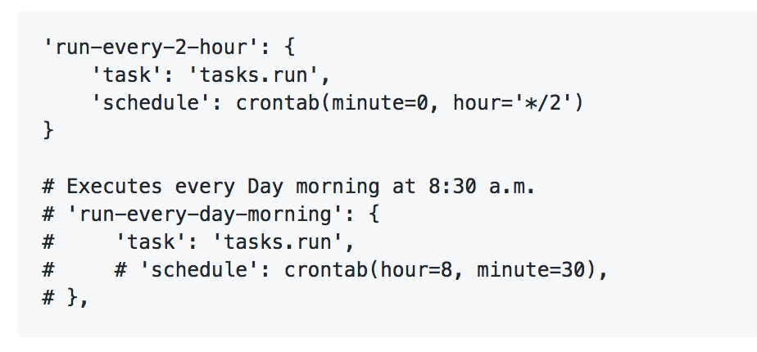
3. Pipeline for regular fetching & retraining
For demo:
the job will be run every 2 hour. If you need to run every day, please uncomment code in "src/Pipeline/celery.py"

Slide 32
3. Pipeline for regular fetching & retraining
Prepare “env.list” (same as Part 1)

Slide 33
3. Pipeline for regular fetching & retraining
Command Lines:
$ docker run --env-file env.list -w /Final/2-Pipeline/ -it besimilar/advanced-data-analysis:pipeline /bin/bash -c "sudo rabbitmq-server -detached; /bin/sleep 5; celery -A Pipeline worker -B -l info"
View Results:
$ docker start <containerID>
$ docker exec -it <containerID> /bin/bash

Slide 34
3. Pipeline for regular fetching & retraining
Start Job (notice the time: 2:06)

Slide 35
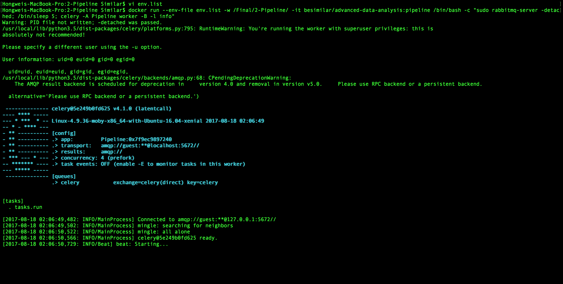
3. Pipeline for regular fetching & retraining
Start Job (notice the time: 2:06)

Slide 36
3. Pipeline for regular fetching & retraining
1st Job Running (4:00)

Slide 37
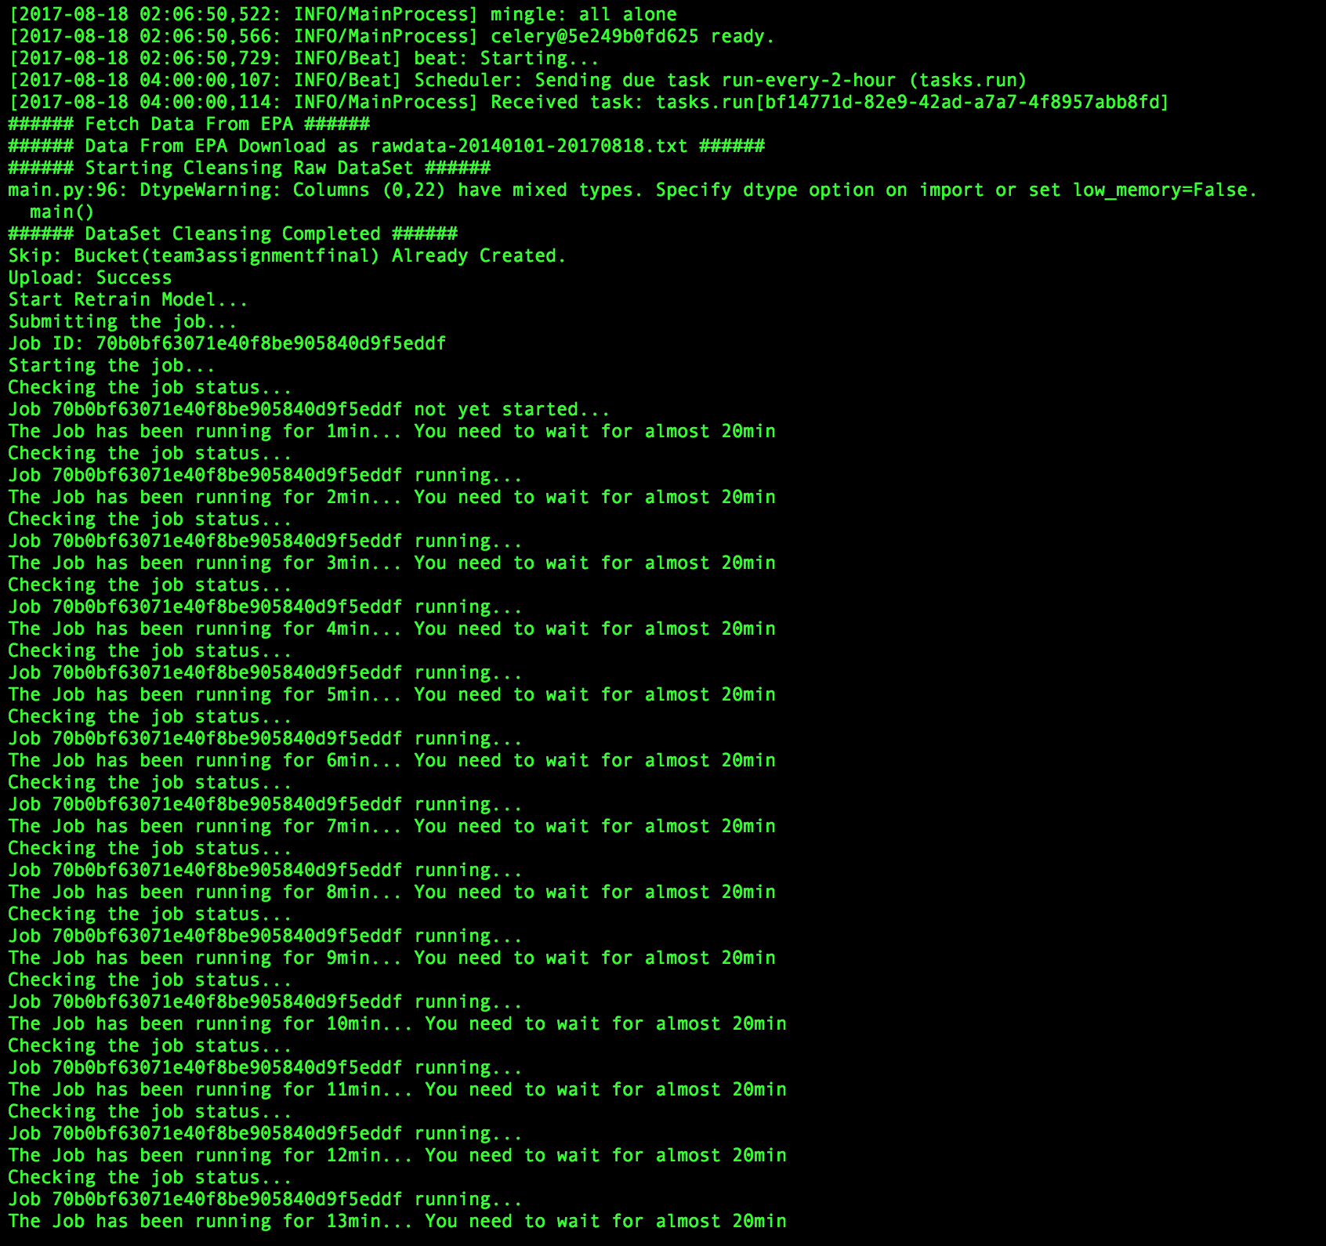
3. Pipeline for regular fetching & retraining
1st Job Running (4:00)

Slide 38
3. Pipeline for regular fetching & retraining
2nd Job Running (6:00)

Slide 39
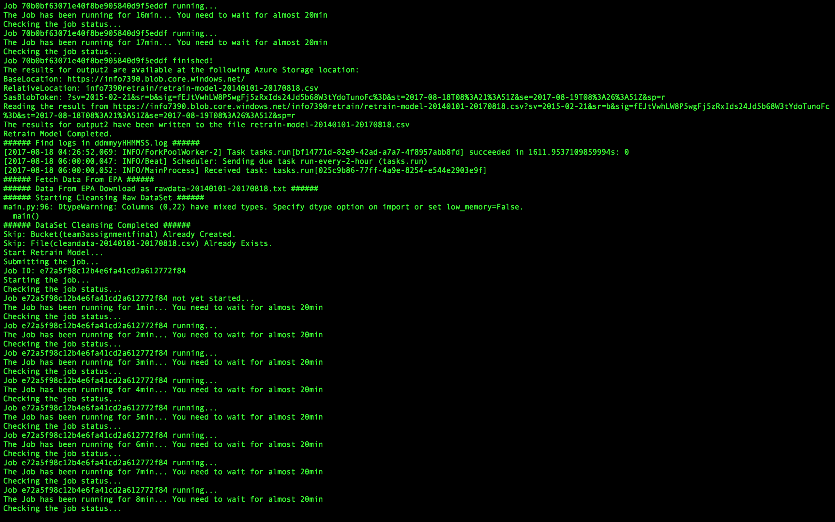
3. Pipeline for regular fetching & retraining
2nd Job Running (6:00)

Slide 40
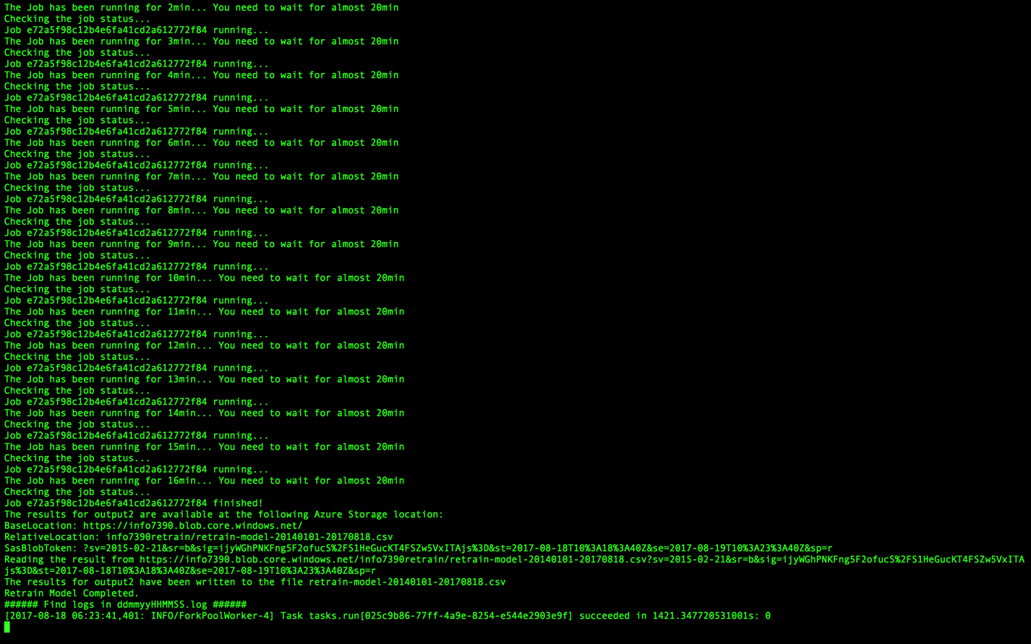
3. Pipeline for regular fetching & retraining
Job End

Slide 41
3. Pipeline for regular fetching & retraining
Job End
It will download retrain result to container as "retrain-model-bdate-edate.csv"
You can also download retrain result from the link shown in terminal

Slide 42
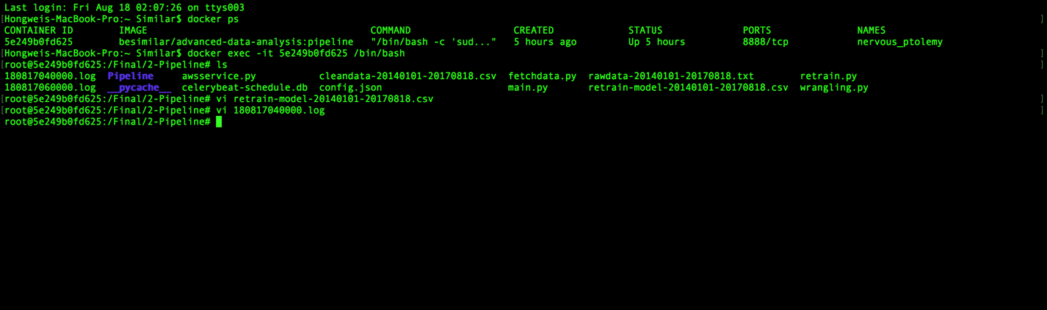
3. Pipeline for regular fetching & retraining

Slide 43
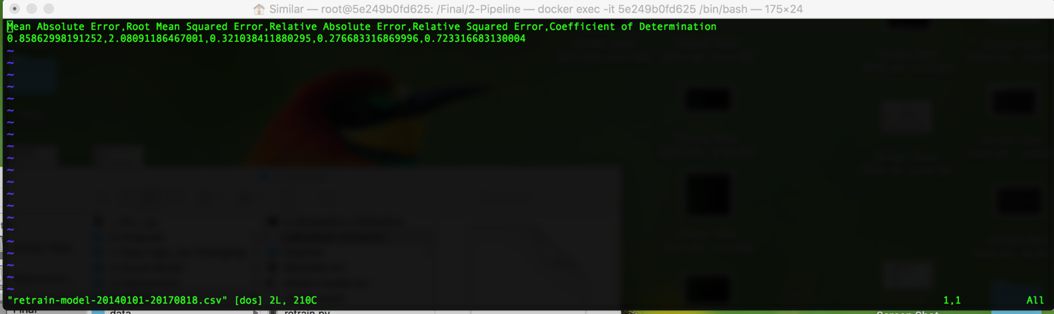
3. Pipeline for regular fetching & retraining

Slide 44
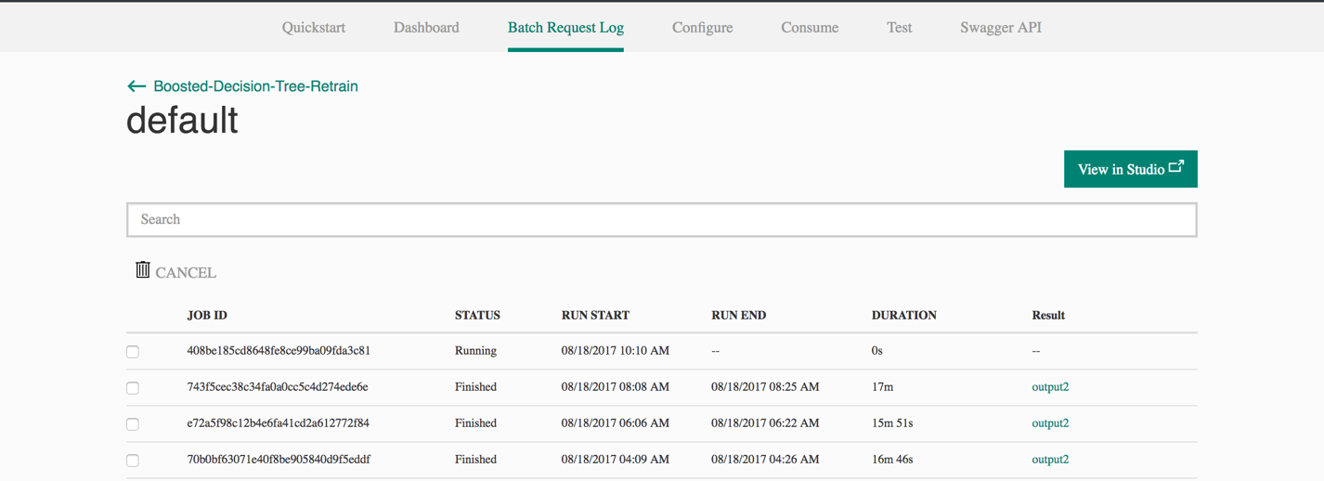
3. Pipeline for regular fetching & retraining

Slide 45
4. deployment
Azure Model
Azure Gallery:
https://gallery.cortanaintelligence.com/Experiment/Boosted-Decision-Tree

Slide 46
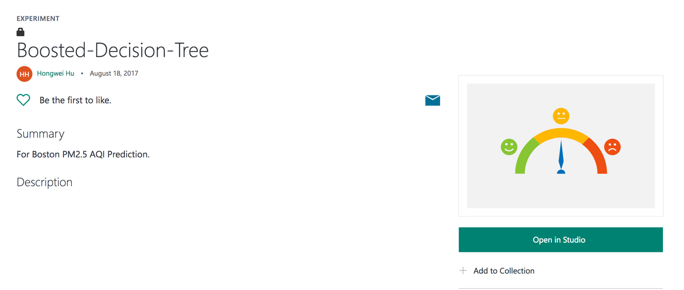
4. deployment
Azure Model
Azure Gallery:
https://gallery.cortanaintelligence.com/Experiment/Boosted-Decision-Tree

Slide 47
4. deployment
For Docker images
You can use “docker pull”
Or You can download from links, and run your own demos
Links:
Data Ingestion & Wrangling: https://s3-us-west-2.amazonaws.com/team3assignmentfinal/boston-aqi.tar
Pipelines: https://s3-us-west-2.amazonaws.com/team3assignmentfinal/boston-aqi-pipeline.tar
Command lines: $ docker load --input <dockerimages>.tar

